Slide 1
10TH UNITED NATIONS WORKSHOP ON SPACE LAW
September 5-8, 2016
SPACE SECURITY AND CYBERSECURITY:
INTERSECTING CHALLENGES
Deborah Housen-Couriel
Interdisciplinary Cyber Research Center, Tel Aviv University

Slide 2

FOCUS ON A CRITICAL NEXUS
SATELLITE COMMUNICATIONS

Slide 4
HOSTILE CYBER OPERATIONS AGAINST
JOINT POLAR SAT SYSTEM
SPACE / GROUND SEGMENTS

Slide 5
NOT NEW / UNIQUE
1997 until present - Turla internet connection hacking group
2007-8 Landsat and Terra AM-1 hacks
summer 2015 - alleged interference with Globalstar’s asset-tracking systems (+ South Korean fishermen)
Ongoing NASA hacks – ground segment

Slide 6
TYPES OF CYBER-ENABLED DISRUPTIONS TO SAT COMM
(via EM SPECTRUM)
JAMMING
MORPHING
HIJACKING TT&C >> COLLISION
‘GRILLING’
TURLA-TYPE
SIGNAL RE-ROUTING

Slide 7
VULNERABILITY THROUGHOUT THE SATELLITE LIFESPAN
Pre-launch and launch
TT&C
Physical destruction or disabling
Disruption of transmissions- full taxonomy
End-of-life events, “crashes”

Slide 8
WORKING DEFINITION:
HOSTILE DISRUPTION OF satCOmm
Physical, cyber-enabled and hybrid disturbance to satellites and satellite communications, originating in a hostile intent to disrupt, damage or otherwise disturb their uninterrupted operation.
“harmful interference” under ITU Constitution + RR
also under Article IX of the OST [query]

Slide 9
THESE ARE HIGH-RISK SCENARIOS
“Because of the criticality of satellite data to weather forecasting, the possibility of a satellite data gap, and the potential impact of a gap on the health and safety of the U.S. population and economy, we added this issue to GAO’s High Risk List in 2013 and it remained on the list in 2015.”

Slide 10
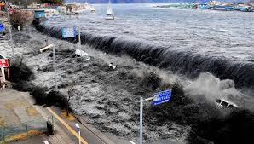
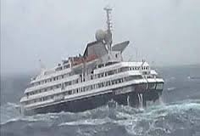
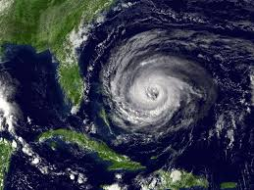
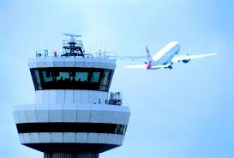
EXTRAPOLATING > LOSS-OF-LIFE SCENARIOS
Notes:
Extrapolate
Reminding us of recent cyber attacks on German nuclear plant and Ukraine electric grid – other crit infrastructure
Even NPT monitoring could be threat of loss of life scenario
Avionisc
Satellites / ground stations not necessarily considered critical infrastructure – they may be – they may not be

Slide 11
THE GROWING CRITICALITY AND URGENCY OF THE PROBLEM AT THE NEXUS
‘PEACEFUL USE’ ISSUES
COLLECTIVE SECURITY ISSUES
SPACE SECURITY
(LAW, POLICY, GOVERNANCE)
CYBERSECURITY (EMERGING LEGAL NORMS, POLICY)
CONCEPTUAL / NORMATIVE ISSUES
LIABILITY ISSUES
STATE PRACTICE NOT TRANSPARENT
SATELLITE CONTROL OF CRITICAL INFRASTRUCTURE >> VULNERABILITIES

Slide 12
4 COMMON CORE CHALLENGES
1
CHANGING ACTORS / STAKEHOLDERS
3
LACK OF NAT’L POLICY TRANSPARENCY
4
LACK OF EFFECTIVE INTN’L COOPERATION
2
DUAL-USE TECHNOLOGIES

Slide 13
HOW IS THE INTERNATIONAL LEGAL COMMUNITY MEETING THIS CHALLENGE AT THE NEXUS OF THE TWO REGIMES?
ONGOING AND PERVASIVE NON-ENGAGEMENT

Slide 14
SPACE + CYBER GGE’s
2013
2015

Slide 15
GGE SPACE
2013
SHANGHAI
PPWT
June 2014 (rev)
EU
CODE OF CONDUCT
March 2014 (rev)
GGE CYBER 2015
SHANGHAI CODE OF CONDUCT
January 2015 (rev)
EU / CoE
Network Security Directive, 2013
Budapest Convention, 2001
Other initiatives:
Canada Proposal, CD, June 2009; ITU-R; UNGA 69/32, 2014; Working Group on 5 Treaties, 2016
Other initiatives:
Tallinn Manuals 1 & 2
Notes:
Inside and outside of UN frameworks
New blocs
Revised versions

Slide 16
THIS IS NOT ONLY A PROCEDURAL OR GOVERNANCE CHALLENGE…
IT’S A SUBSTANTIVE ONE.

Slide 17
BRIEF CASE STUDY
AT WHAT THRESHOLDS DO HOSTILE SATCOMM DISRUPTIONS
AN ILLEGAL USE OF FORCE IN SPACE AND CYBERSPACE?

Slide 18
G7 / G20 PRINCIPLES AND ACTIONS ON CYBER, 2016
-- NATO, article 5
-- US, UK, NL
APPLICABILITY OF INTERNATIONAL LAW IN CYBERSPACE

Slide 19
UN 2(4)
All members shall refrain …from the threat or use of force against the territorial integrity or political independence of any state...

Slide 20
UN 51
Nothing in the present Charter shall impair the inherent right of …self-defense if an armed attack occurs against a Member of the UN...

Slide 21
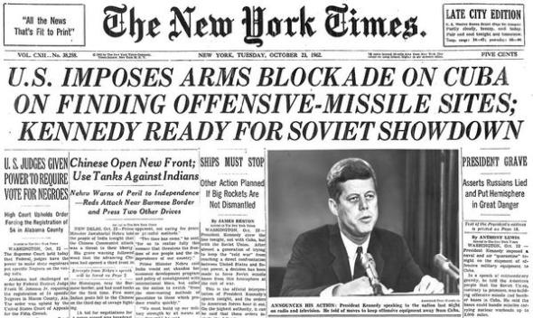
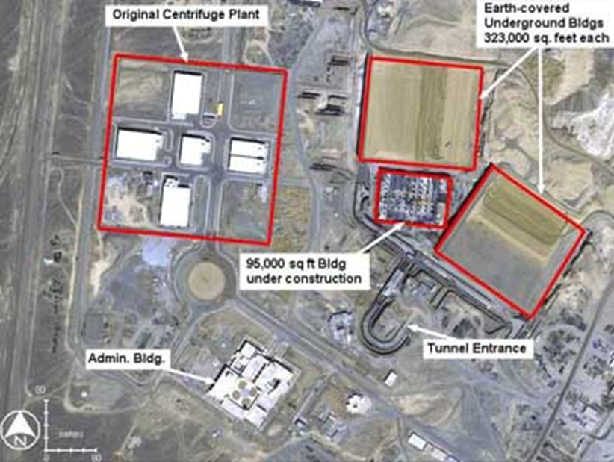
ANTICIPATORY / PRE-EMPTIVE SELF-DEFENCE
“No state can be expected to await an initial attack which…may well destroy the state’s capacity for further resistance and so jeopardize its very existence.”
Derek Bowett, 1958
Notes:
Osirak

Slide 22
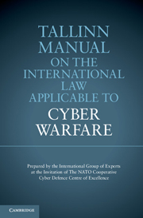
LEADING EXPERT AUTHORITIES
NOT STATES (FOR GOOD REASON)
INTERNATIONAL LAW AND COLLECTIVE SECURITY APPLY
STATES’ DE FACTO ACKNOWLEDGEMENT
2013

Slide 23
RULE 30: “CYBER ATTACK”
A cyber attack is a cyber operation, whether offensive or defensive, that is reasonably expected to cause injury or death to persons or damage or destruction to objects.

Slide 24
RULE 11: “USE OF FORCE”
A cyber operation constitutes a use of force when its scale and effects are comparable to non-cyber operations rising to the level of a use of force.
(ICJ Nicaragua 1986)

Slide 25

A decision as to when a cyber attack would lead to the invocation of Article 5 would be taken…on a case-by-case basis.
Cyber attacks … could be as harmful to modern societies as a conventional attack … cyber defence is part of NATO's core task of collective defence.

Slide 26
HARMFUL DISRUPTION VULNERABILITIES:
CYBER ATTACKS ON SATELLITE COMMS CAN CONSTITUTE PROHIBITED USES OF FORCE
Pre-launch and launch
TT&C
Physical destruction or disabling
Disruption of transmissions- full taxonomy
End-of-life events, “crashes”

Slide 27
SUMMING UP
Hostile disturbances to satellite transmissions constitute real threats and challenges, with significant ramifications for collective security.
These challenges intersect because satellite communications are cyber operations.
Beyond operative and governance issues, there are important normative overlaps.
While there’s some intergov’t progress re admin measures – TCBMs, BPs (GGE’s)…

Slide 28
1
Insufficient awareness of the operational and normative overlaps
2
The necessary and critical conversation between these 2 legal regimes has yet to begin

Slide 29
NEXT STEPS: WHAT’S TO BE DONE AND WHO SHOULD DO IT?
CONSIDER HOW TO MOVE JOINTLY
FROM TCBMs TO SUBSTANTIVE
NORMS
AS NORMATIVE WORK IS ONGOING – IDENTIFY AND SHARE BEST PRACTICES (ENCRYPTION)
MERGE WORK PROCESSES OF RELEVANT INTER-GOV’T INITIATIVES (CO-COMMITTEES, CONFERENCES)
CRITICAL CHALLENGES FOR LEGAL AND POLICY COMMUNITIES
Notes:
Paralllells with the challenges that Sgobba described re global space traffic management – no one wants to discuss jurisdictional issues because they want to maintain freedom of action

Slide 30

“DE-SILO”

Slide 31
THANK YOU.
deborah@cyberregstrategies.com

